Slide 1
Machine Learning aided Record Linkage
Final Project for the Data Architecture course
Francesco Porto (816042) francesco stranieri Mattia Vincenzi (860579)

Slide 2


Outline
Record Linkage
Python Record Linkage Toolkit
Our project
Experiment 1: Full Index vs Block Index
Experiment 2: Training and Testing the model
Conclusions and final remarks

Slide 3
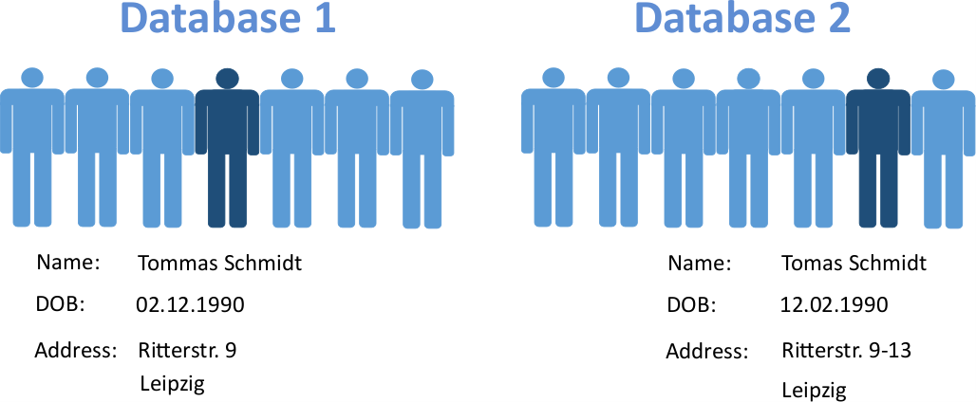

Record Linkage
Record Linkage is the process of finding records in one or more datasets that refer to the same entity across different data sources.
Traditionally: apply a set of fixed rules
Our project: use Machine Learning methods to obtain better results

Slide 4
Python Record Linkage Toolkit
Simple framework for Record Linkage in Python
Record linkage is seen as a pipeline:
Preprocessing: clean the datasets
Indexing: create pairs of records (candidate links)
Comparison: compare record pairs via different algorithms, thresholds, etc.
Classification: classify record pairs into matches or non-matches
Evaluation: evaluate classification results
Preprocessing
Indexing
Comparison
Classification
Evaluation
Documentation available at the following address: https://recordlinkage.readthedocs.io/en/latest/index.html

Slide 5
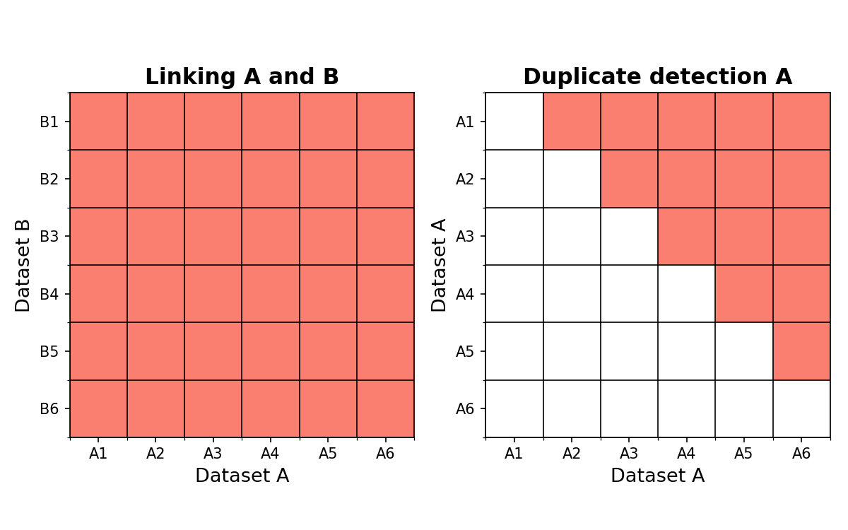
Our project – Experiment 1: Full Index vs Block Index
Two types of Indexing methods are available:
Full Index: make the cartesian product of the records in the first dataset and the records in the second one
Block Index: only finds a subset of the cartesian product, according to some dataset attributes
Question: Is there a tradeoff between speed and accuracy?

Slide 6
Our project – Experiment 1: Full Indexing

